Slide 1
PLastic TRansfer CUrrent

Slide 2
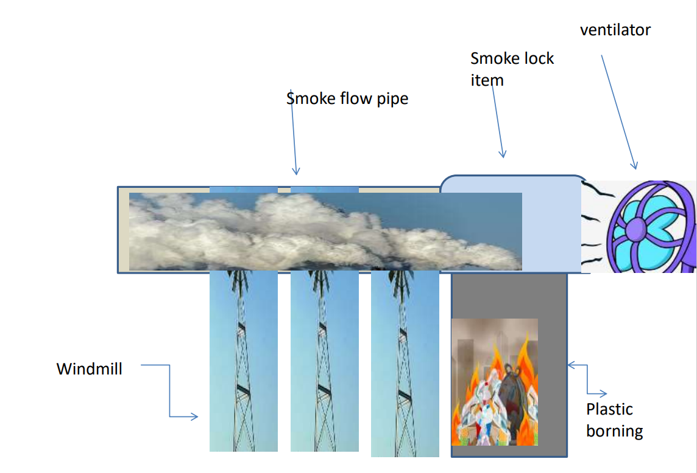
Project idea

Slide 3

Model method

